Slide 1
Project Title: "Analyzing NYC Airbnb Open Data"
Team Members: Abinanthan Myilsamy Kathiresan, Baoduo Lv, Jasmine He, Terry Lu, Haoxuan Wang

Slide 2
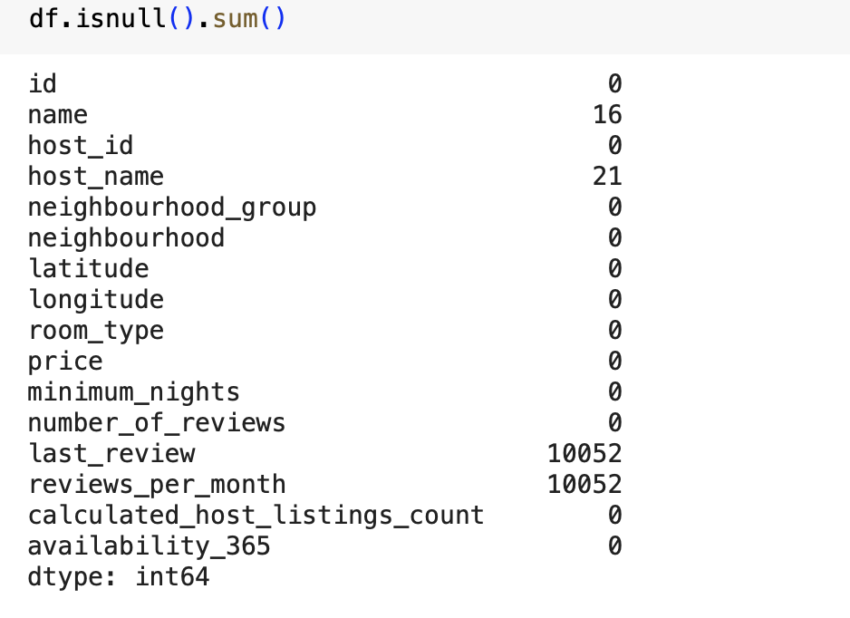
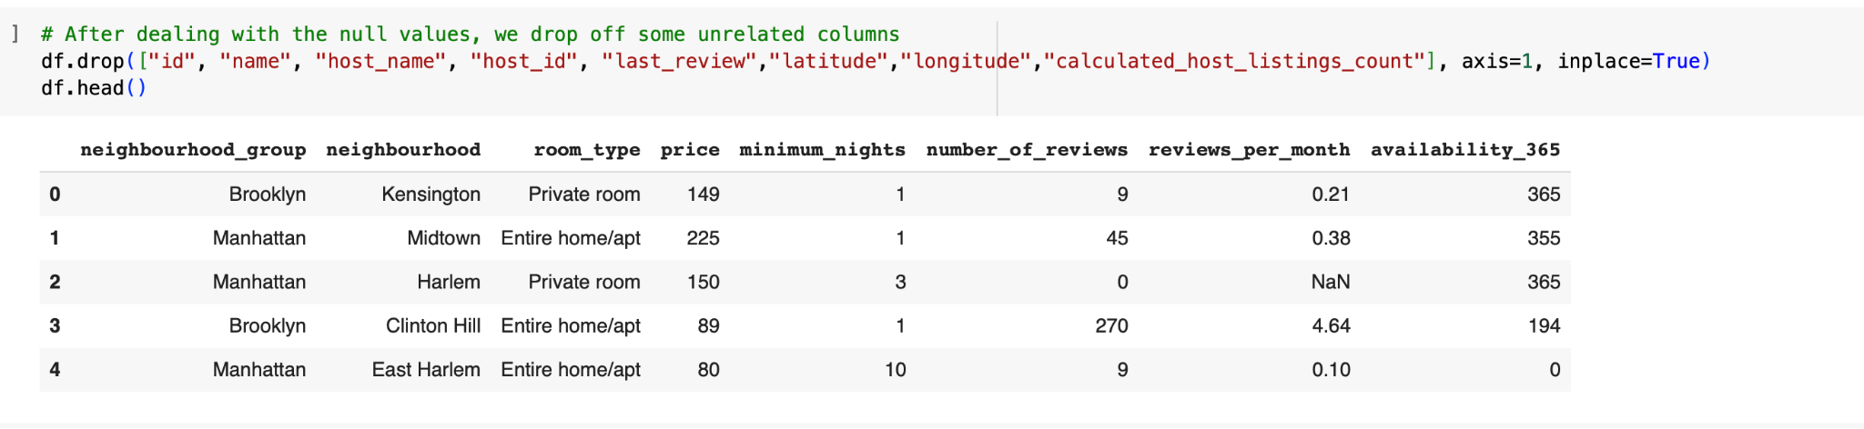
Introduction
Project objectives:
predict NYC airbnb rental Price based on various features, conduct a comprehensive analysis of the NYC Airbnb dataset and derive actionable insights for hosts and potential renters.
State the significance of the NYC Airbnb dataset
2.DataSet Overview: parameters in the dataset that we are using to analyze the Data
listing ID
name of the listing
Host ID
name of the host
………
3. Data preprocessing: find null value & get rid of them

Slide 3
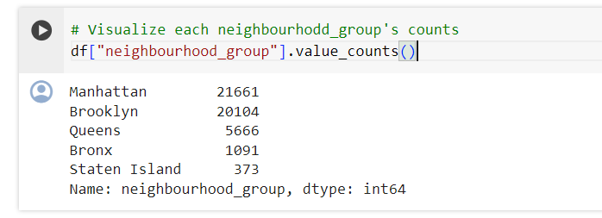
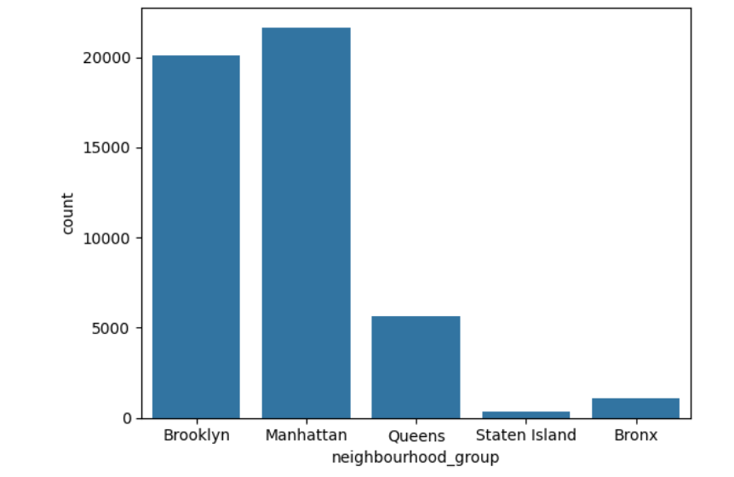
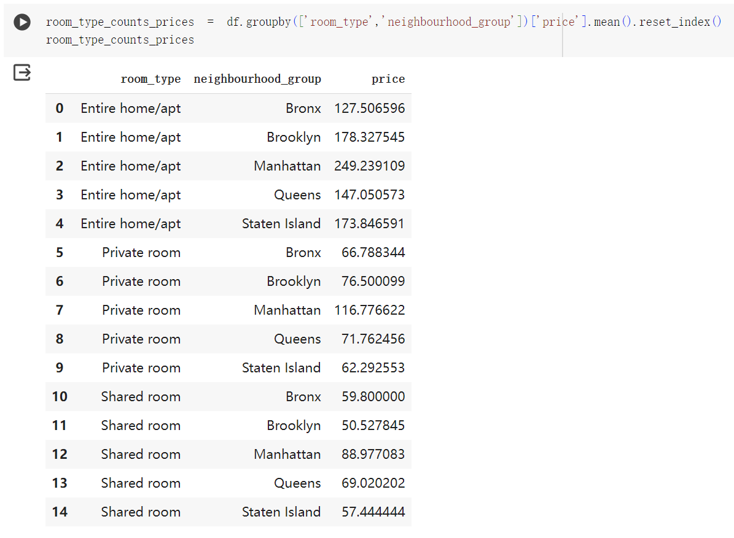
Exploratory Data Analysis (EDA)
Understanding the distribution of Airbnbs across boroughs is insightful. To visualize this, we created a histogram detailing the count of Airbnbs in each borough.
Distribution of Airbnb Host
Manhattan has the highest number of Airbnbs -> the most popular borough.
Conversely, Staten Island has the fewest Airbnbs -> the least popular.
Average Price vs. different room types in different areas
We used the groupby and mean() method on our dataframe to calculate each average price:
For a ceratin room type
(Entire apartment / Private Room / Shared Room)
In a ceratin area
(Bronx / Brooklyn / Manhattan / Queens / Staten Island)

Slide 4
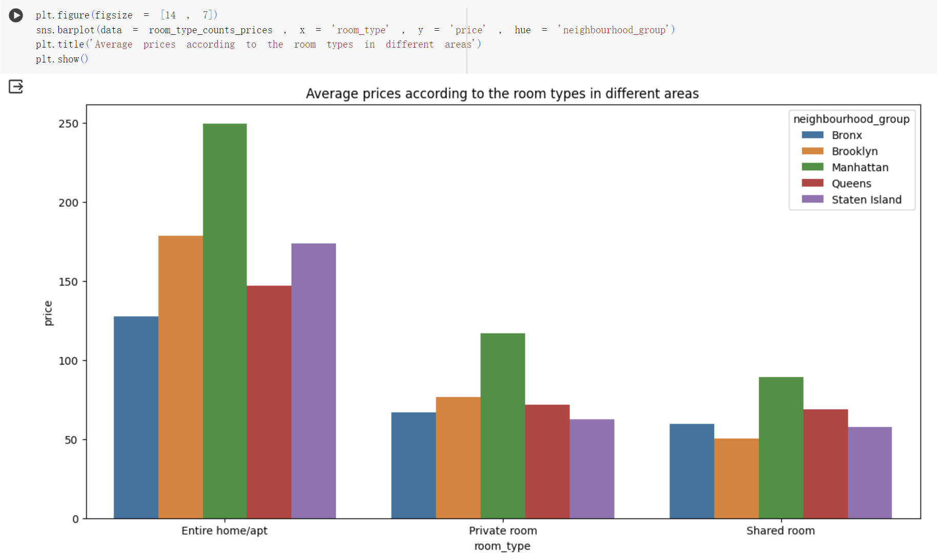
Visualization

Slide 5


Linear and Lasso Model
Linear Regression
It is a statistical method that models the relationship between a dependent variable and one or more independent variables using a linear equation.
Equation
where beta(i) is the coefficient and xi is the independent variable.
LASSO regression
LASSO (Least Absolute Shrinkage and Selection Operator) is a type of linear regression that includes a penalty term (regularzation term) to shrink some coefficients to zero.
Equation
To minimize the loss function:
λ controls the penalty strength
Purpose: Solve the issue of overfitting.

Slide 6
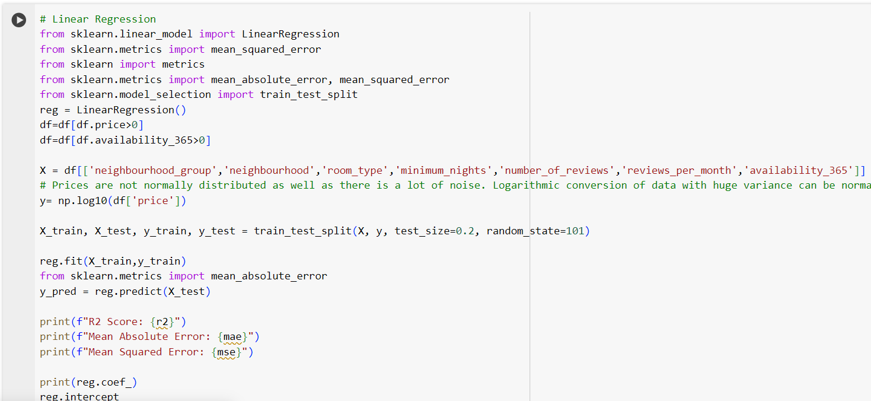
Apply Linear and Lasso Model

Slide 7
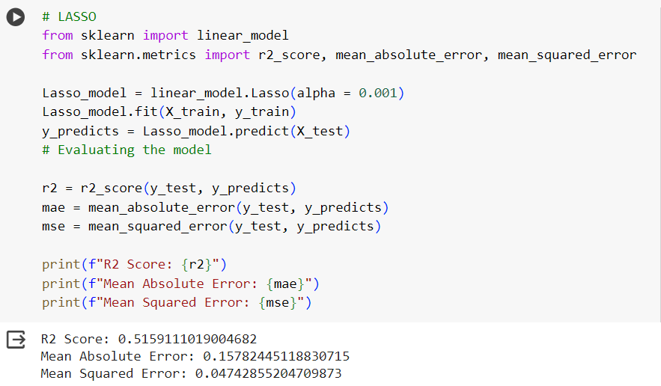
LASSO Model

Slide 8
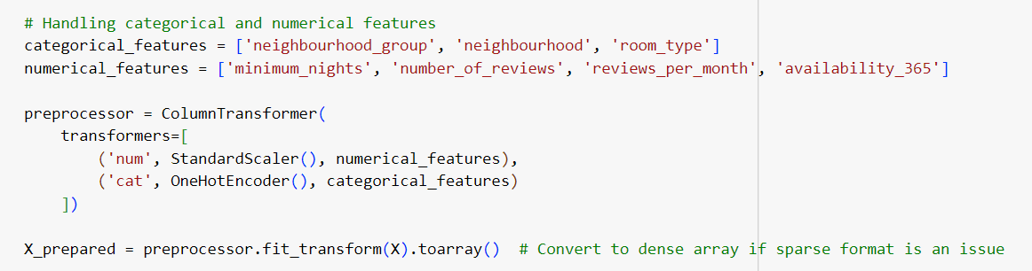

Neural Network
Given the complexity of the dataset and the variety of parameters, neural network may be a better alternative to predict the rental price.

Slide 9
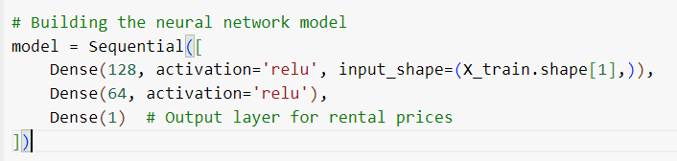
Neural Network
3 Layers:
The first layer is a fully connected (Dense) layer with 128 neurons
A second fully connected layer with 64 neurons. It further processes the information transformed by the first layer.
The output layer has a single neuron. In a regression problem, this neuron will output the numeric value that corresponds to the model’s prediction.

Slide 10
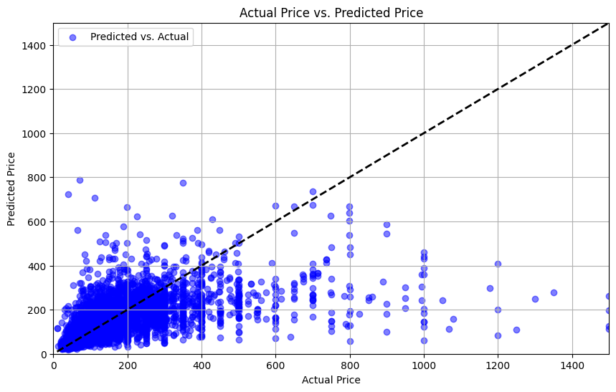
Performance

Slide 11
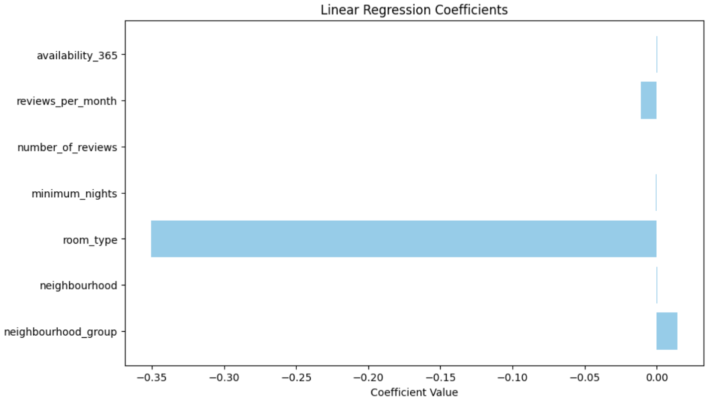
Outcome Analysis

Slide 12


Comparison of Two Models
Linear Lasso Model:
Neural Network:

Slide 13
Results
Through the outcome analysis, the room type is the most critical parameter in determining the price.
Neighborhood group, neighborhood, availability 365 has positive effects on price
Minimum nights, number of reviews, reviews per month has negative effects on the price
The Neutral Network Model shows the least number of mean squared error with best prediction. Lasso model is also good in prediction with a slightly lower R^2 value.

Slide 14
Thank you for watching

